Slide 1

Epileptic Seizure Detection and Notification System
Second Iteration Review
Team #19063
Sponsors - Iwan R Grau, Palanivel Guruvareddiar
Mentor - Catherine Merrill
Team members:
Alejandro Ortega
Gordon Downs
Louie Bertani
Juan Gastélum
K Humberto Lopez Felix

Slide 2
Objectives of the ISR
Our objectives for ISR are:
Present the SDNS as-built configuration
Present SDNS verification process until now, and present evidence of that verification
Explain the impact of our progress so far, and how it enables us to continue forward
Present complete requirement decomposition
Present the expected design for FAR
We have built and verified our ISR SDNS,
and we are ready to build and verify our FAR SDNS.
Notes:
Give overview of the goals of the review (not the iteration)

Slide 3
ISR Overview
Introduction
Purpose of Review and Scope
System Block Diagram
End Item ConOps
Second Iteration Goals
Goals for ISR
System Requirements Flowdown
Current SDNS Description
Second Iteration TDP
Design Comparison with CDR
Changes
Second Iteration Performance
SRVM
ATP
Performance for Next Delivery
FAR Design Goals
System Requirements to Fulfill
FAR Design
Hardware
Image Analysis Software
Notification App
Full Verification Plan
Risk Assessment
Risk Matrix
Schedule and Cost Tracking
Schedule
Cost
Summary

Slide 4
1.0 Introduction

Slide 5
1.1 Purpose and Scope
The Seizure Detection and Notification System (SDNS) is designed to monitor epileptic patients during their sleep, and to notify caregivers in case a seizure is detected to reduce patient mortality
Previously, for CDR, our MVP was built with the purpose of collecting data to mitigate risk and to satisfy several system requirements
Image capture requirements were verified, image processing was partially verified, and notification system was left for later iterations
Three subsystems compose the SDNS: Image Capture, Image Analysis and Notification
Image Capture (Depth Camera) sends data to Image Analysis
Image Analysis receives data and determines whether a seizure is occurring. It sends an alert to the Notification subsystem if so
Notification subsystem then triggers an alarm on the smartphone to alert the caregiver of the patient’s seizure
For ISR, we present the current SDNS, as well as evidence of its performance, and the following steps to reach FAR Goals.
Notes:
Objective is to remind the panel of our system, what we did for CDR, and what we have done until this ISR.

Slide 6
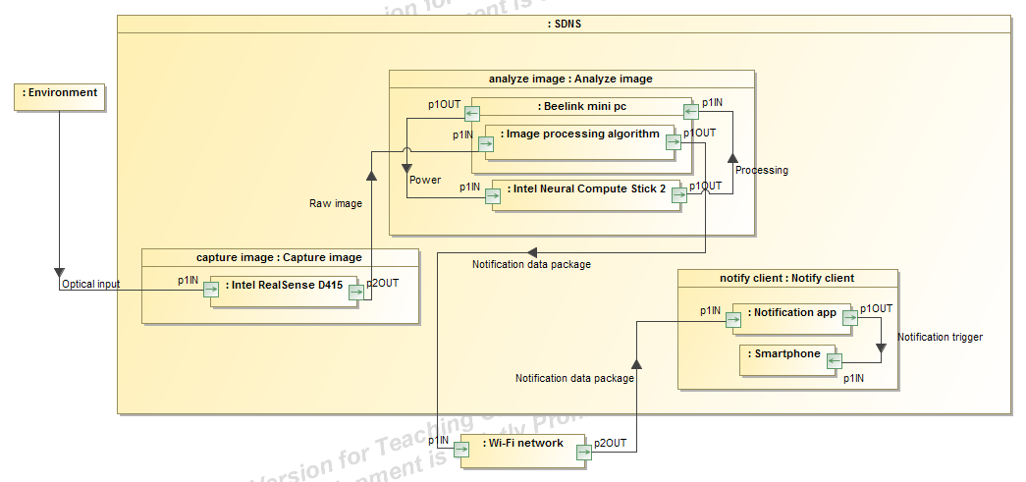
1.2 System Block Diagram
We understand the interaction between the different components of the SDNS.
Notes:
The idea here is to remind the panel of the multiple subsystems and components that are present in our SDNS. Explain if anything changed (which I believe in terms of the block diagram we have not changed anything, maybe include the server we want to set up for notifications over the internet)

Slide 7
1.3 End Item ConOps
Open source: Our system is meant to be utilized by the community, in which users can download the software for free, purchase the hardware, and monitor patients who have epilepsy.
However, an alternative use is proposed, where the open source community can further improve the system. Developers could improve the algorithms and users could provide additional training data so that the system can continue to grow and benefit the epilepsy community.
This information can be found in our End Item ConOps (101-ConOps-RevB-200303)
We understand the scope of the project, as well as the Use Cases of the final SDNS

Slide 8
2.0 Second Iteration Goals

Slide 9
2.1 Goals for ISR
For CDR, we verified the following system and subsystem requirements:
SR 1.1 (Capture and save images): Verified completely (CT)
SR 1.2 (Process images in real-time): Partially verified (R)
SSR 1.2.1 (process motion detection in real time): Verified
SR 1.3 (Accuracy of SDNS): Partially verified (CT)
SSR 1.3.1 (Motion detection accuracy): Verified
SSR 1.3.2 (Motion through bed sheet): Verified
SR 1.5 (Operation in desired conditions): Verified (CT)
CT: Critical Technology
R: Risk
We have a clear understanding of what our goals were for this review in terms of system requirement prioritization, risk mitigation and critical technology
Notes:
The point here is to make clear to the panel that we understand what we did for this review so that we are one step closer to our final design. The rationale for our work is based of mitigating risks, completing system requirements, and developing critical technology.

Slide 10
2.1 Goals for ISR
For this review, we verified the following system and subsystem requirements:
SR 1.2 (Process images in real-time): Fully verified (R)
SR 3.1 (Make and Store log file of events): Fully Verified (CT)
SR 3.2 (Output log file on command): Partially Verified (CT)
SSR 3.2.2 (Display log): Fully Verified
SSR 3.2.3 (Export log): Fully Verified
CT: Critical Technology
R: Risk
We have a clear understanding of what our goals were for this review in terms of system requirement prioritization, risk mitigation and critical technology
Notes:
The point here is to make clear to the panel that we understand what we did for this review so that we are one step closer to our final design. The rationale for our work is based of mitigating risks, completing system requirements, and developing critical technology.

Slide 11
2.2 System Requirement Flowdown
Full list of system requirements and their flowdown are present in document 100,102 System Requirements Document RevB
Updated Flowdown:
SR 1.3 (Accuracy of the system)
SSR 1.3.3: The image analysis subsystem shall detect a seizure with 90% accuracy
SR 1.4 (Time to detect seizure)
SSR 1.4.1: The image analysis subsystem shall detect a seizure within 10 seconds of the clonic phase starting.
SR 2.1 (Trigger alarm if seizure)
SSR 2.1.1: The image analysis subsystem shall send a data packet to the notification subsystem.
SSR 2.1.2: The notification subsystem shall trigger an alarm after receiving a data packet from the image analysis subsystem.
SR 2.2 (Wireless delivery of alert)
SSR 2.2.1: The image analysis subsystem shall send a data packet to the notification subsystem over the internet.
All system requirements have been flowed-down into subsystem level to allow for verification of the SDNS
Notes:
The point here is to show the panel we have a full decomposition of system requirements but there is no need to read it all. Rather emphasize on what requirements have been recently modified or decomposed.

Slide 12
2.2 System Requirement Flowdown
Updated Flowdown (Continued):
SR 2.3 (Time for alarm from seizure detection)
SSR 2.3.1: The notification subsystem shall receive a data packet that triggers an alarm within 5 seconds of the the image analysis subsystem detecting a seizure.
SR 3.1 (Create and keep a log file of events)
SSR 3.1.1: The notification subsystem shall create and store a log (database) working in FIFO fashion, containing information about time and date of detected seizures.
SR 3.2 (Output of log file)
SSR 3.2.1: The image analysis subsystem shall send entries to the log as JSON files to the notification subsystem.
SSR 3.2.2: The notification subsystem shall open the log and display it on the smartphone’s screen.
SSR 3.2.3: The notification subsystem shall allow the user to export the log as a .txt file through the smartphone app.
All system requirements have been flowed-down into subsystem level to allow for verification of the SDNS
Notes:
The point here is to show the panel we have a full decomposition of system requirements but there is no need to read it all. Rather emphasize on what requirements have been recently modified or decomposed.

Slide 13
3.0 Current SDNS Description

Slide 14
3.1 Second Iteration TDP
Changes since CDR
Image analysis software design updated (SDD)
Unnecessary documents removed; SRVM and filled-out test sheets added
Distinction between SDNS and our MVP Data Collection System (DCS) clarified
New features
Seizure detection algorithm updated; realtime performance achieved
Motion detection removed from image analysis
Smartphone app implementation:
Skeleton of app finished
Log file generation
Changed from local network transfer to server-based communication
Informed Consent Document
We have released a new revision of our TDP to agree with the current status of the SNDS
Notes:
Objective here is to explain what is new of this TDP release

Slide 15
3.2 Changes from CDR Report
A change class I is a change that will change the main functionality of the system, while a change class II is any change that will not affect the main functionality of the system
TDP Report- Change Control Log
Doc# | Rev Description | Class | Revision | Date
100,000 | Deleted “1.1 Relevant Personnel”, not part of TDP | II | RevA1 | 200303
100,000 | Deleted “3.0 Cost Breakdown”, not part of TDP | II | RevA2 | 200303
100,000 | Deleted “4.0 Project Deliverables and Timeline”, not part of TDP | II | RevA3 | 200303
100,000 | Deleted “4.1 Project Schedule”, not part of TDP | II | RevA4 | 200303
100,000 | Deleted “6.0 Action Items from CDR”, not part of TDP | II | RevA5 | 200303
100,101 | 1.0 Introduction and 6.0 System Constraints: Added USA to country list for clinical trials | II | RevA1 | 200303
100,101 | 7.0 System Use: Added open-source community alternative | II | RevA2 | 200303
100,102 | Rewording and expansion of system requirements by completing flowdown to subsystems level | II | RevA2 | 200303
100,102 | Update of SRVM based on requirement flowdown and verification procedures | II | RevA4 | 200303
We understand the changes made to the SDNS, and we have documented them appropriately
Notes:
Here we present a table with all the engineering changes made to our system. The rubric talks about red-lines which I am unsure of what they are but it says we need to incorporate them somehow

Slide 16
4.0 Second Iteration Performance

Slide 17
4.1 SRVM
Requirement # | Requirement Title | Verification Method | Required Value | Units | Oper-ation | Actual Value | Pass/ Fail | Margin | First Verification
SR1.2 | Image Processing | Test | 16 | FPS | >= | 61.41 | Pass | N/A | ISR
SSR1.2.1 | Motion Rate | Test | 16 | FPS | >= | 61.41 | Pass | 45.41 | CDR
SSR1.2.2 | Seizure Rate | Test | 16 | FPS | >= | 71.77 | Pass | 55.77 | ISR
SR2.1 | Alarm | Test | 10 | Yes | = |  |  |  | FAR
SSR2.1.1 | Notif Send | Test | 10 | Yes | = | 0 | Fail |  | ISR
SSR2.1.2 | Notif to Alarm | Test | 10 | Yes | = |  |  |  | FAR
We understand the system requirements that encompass the SDNS, and what we need to do going forward to finish verification

Slide 18
4.1 SRVM
Requirement # | Requirement Title | Verification Method | Required Value | Units | Oper-ation | Actual Value | Pass/ Fail | Margin | First Verification
SR3.1 | Keep Log | Inspection | TRUE | Boolean | = | TRUE | Pass | N/A | ISR
SSR3.1.1 | Create and keep log FIFO | Inspection | TRUE | Boolean | = | TRUE | Pass | N/A | ISR
SR3.2 | View Log | Inspection | TRUE | Boolean | = |  |  | N/A | ISR
SSR3.2.1 | Send entries as JSON | Inspection | TRUE | Boolean | = |  |  | N/A | FAR
SSR3.2.2 | Display Log | Inspection | TRUE | Boolean | = | TRUE | Pass | N/A | ISR
SSR3.2.3 | Export Log | Inspection | TRUE | Boolean | = | TRUE | Pass | N/A | ISR
We understand the system requirements that encompass the SDNS, and we present the results of verifying several requirements

Slide 19
4.2 ATP
No changes made to previous testing procedures
Test 10.0 IMG_Ana_T4 Passed
New test procedures added for requirements to be verified at ISR
SR1.2, SSR1.2.2. SSR2.2.1
Inspection completed for ISR requirements
SR3.1, SSR3.2.2, SSR3.2.3
Full verification roadmap defined for FAR
Refer to Document 100,204 V&A
We present update on ATP, highlighting relevant testing results, and new test procedures
Notes:
Objective here is to present the new results and new test procedures we have made. No need to go deep when speaking, just simple overview but include all information

Slide 20
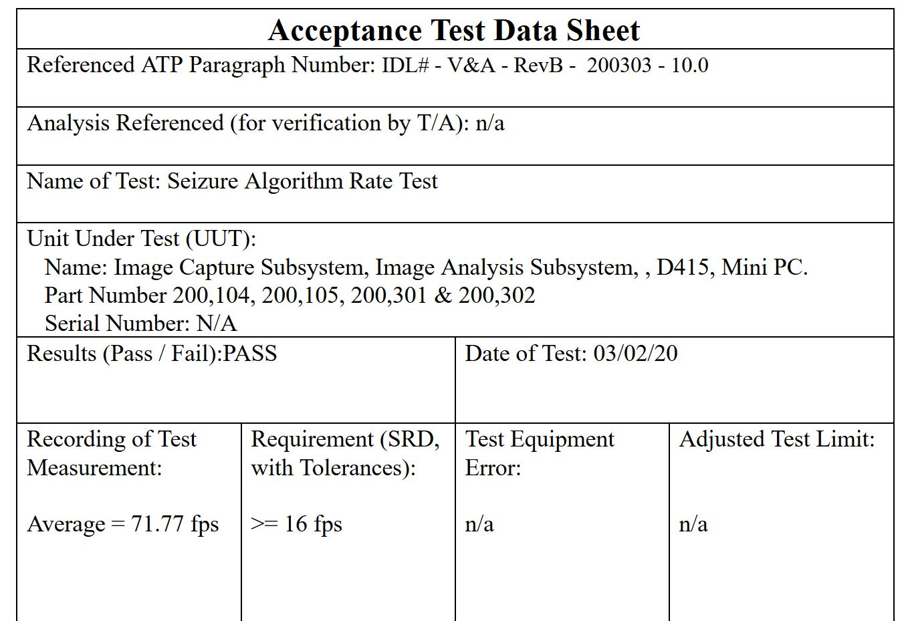
Seizure Algorithm Rate Test
IMG_Ana_T4
SSR1.2.2
Tester to load data that is processed by the seizure detection algorithm
System outputs the time to process each 30-frame window and FPS is calculated from that for each analysis.
If all are above 16fps, test passed.

Slide 21
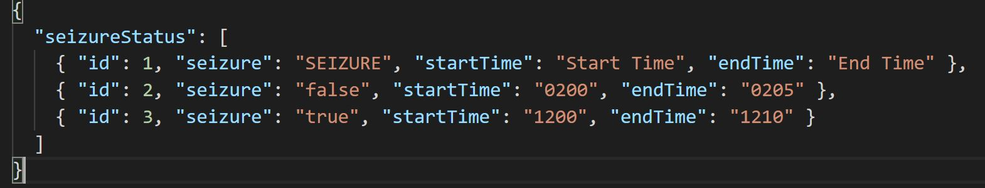
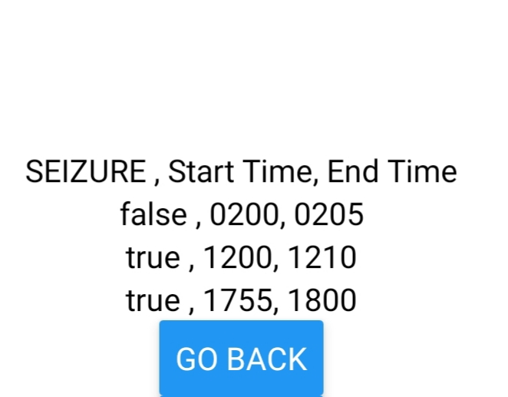
App Log Inspection
App can read in JSON file with predefined structure
Able to add new events to JSON file
Display in FIFO

Slide 22
4.3 Performance for FAR: Margins
SR1.3: Detect seizures with 90% accuracy
Current: N/A
Difference: 90% accuracy required
SR1.4: Detect seizure within 10 seconds of clonic phase starting
Current: Takes 0.4 sec to analyze 1 sec windows.
Difference: 8.6 second margin if successful in first analysis.
Have 9 attempts with current seizure detection method.
SR2.3: Alarm triggers within 5 sec of seizure detection
Current: N/A
Difference: 5 sec for sending and receiving notification and setting off alarm
(307 - SRVM - RevB - 200303 - “System Requirements Verification Matrix”)
We understand the performance our SDNS must reach to reach verification of its system requirements.
Notes:
Explain the numbers we need to reach in the tests to fully verify the SDNS. Point to SRVM for visual assistance

Slide 23
5.0 FAR Design Goals

Slide 24
5.1 System Requirements to Fulfill
Outstanding system requirements that were planned for ISR
All outstanding system requirements are related to communication between mini PC and smartphone app.
Solving that problem will satisfy all requirements planned for ISR.
Req # | Req description | Req verification description
SSR 2.1.1 | Mini PC sends packet to app | (T) Notification sent & received, 10/10
SR 2.2, SSR 2.2.1 | System sends packet wirelessly, over the internet | (T) Notification sent & received wirelessly, over the internet 10/10
SR 3.2 | System outputs log file populated by mini PC | (I) System outputs log file with data from mini PC
SSR 3.2.1 | Data sent from mini PC to app | (I) Necessary data sent between devices
Send & receive
notification
Log data
received
We have a plan to finalize the SDNS to fulfill system requirements.
Notes:
Here we explain what system requirements are missing verification as well as relating this to our final ConOps in terms of what verifying these system requirements allow the system to do (detect seizures or grow from the open source community).

Slide 25
5.1 System Requirements to Fulfill
System requirements decomposed for FAR:
Req # | Req description | Req verification description
SR 1.3, SSR 1.3.3 | Detect seizures with at least 90% accuracy | (T) Run mixed test set of depth videos. 90% average across positives and negatives
SR 1.4, SSR 1.4.1 | Detect seizures within 10 seconds of start of clonic phase | (T) Run seizure test set of depth videos. 90% of detections within 10 seconds
SR 2.1, SSR 2.1.2 | Trigger phone alarm when seizure is detected | (T) 10/10 seizure detections trigger alarm
SR 2.3, SSR 2.3.1 | Alarm triggers within 5 seconds of seizure detection | (T) 10/10 seizure detections trigger alarm within 5 seconds
Detect
seizures
Trigger
alarm
We have a plan to finalize the SDNS to fulfill system requirements.
Notes:
Here we explain what system requirements are missing verification as well as relating this to our final ConOps in terms of what verifying these system requirements allow the system to do (detect seizures or grow from the open source community).

Slide 26
5.1 System Requirements to Fulfill
System requirements decomposed for FAR:
Req # | Req description | Req verification description
SR 1.3, SSR 1.3.3 | Detect seizures with at least 90% accuracy | (T) Run mixed test set of depth videos. 90% average across positives and negatives
SR 1.4, SSR 1.4.1 | Detect seizures within 10 seconds of start of clonic phase | (T) Run seizure test set of depth videos. 90% of detections within 10 seconds
SR 2.1, SSR 2.1.2 | Trigger phone alarm when seizure is detected | (T) 10/10 seizure detections trigger alarm
SR 2.3, SSR 2.3.1 | Alarm triggers within 5 seconds of seizure detection | (T) 10/10 seizure detections trigger alarm within 5 seconds
Detect
seizures
Trigger
alarm
Must change tests if no seizure data is obtained very soon
We have a plan to finalize the SDNS to fulfill system requirements.
Notes:
Here we explain what system requirements are missing verification as well as relating this to our final ConOps in terms of what verifying these system requirements allow the system to do (detect seizures or grow from the open source community).

Slide 27
6.0 FAR Design

Slide 28
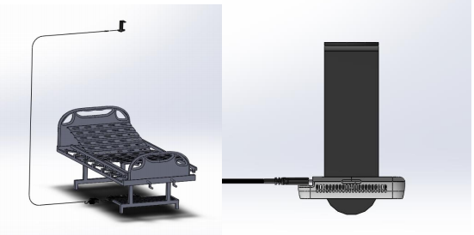
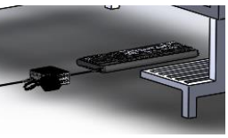
6.1 Hardware
Hardware components are the same as in CDR (Refer to 100,301 Drawing Package RevA)
Mini PC with quad core 1.5 GHz Intel Celeron, 8GB RAM, 256GB SSD.
Intel RealSense D415 Camera
For FAR, there might be an addition of a USB 3.0 Intel Neural Compute Stick in case additional processing power is required
We understand the hardware required for final SDNS
Notes:
Give overview of hardware for FAR, highlighting changes and components and subsystems not yet developed.

Slide 29
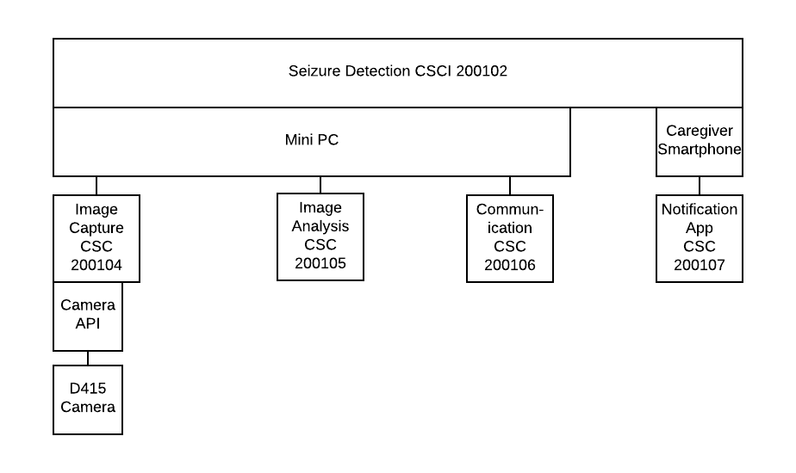
6.2 Image Analysis Software
Software component interactions
We understand the software required for final SDNS
Notes:
Explain the software components and their interactions that allow the SDNS to function. Highlight changes and advancements mostly

Slide 30
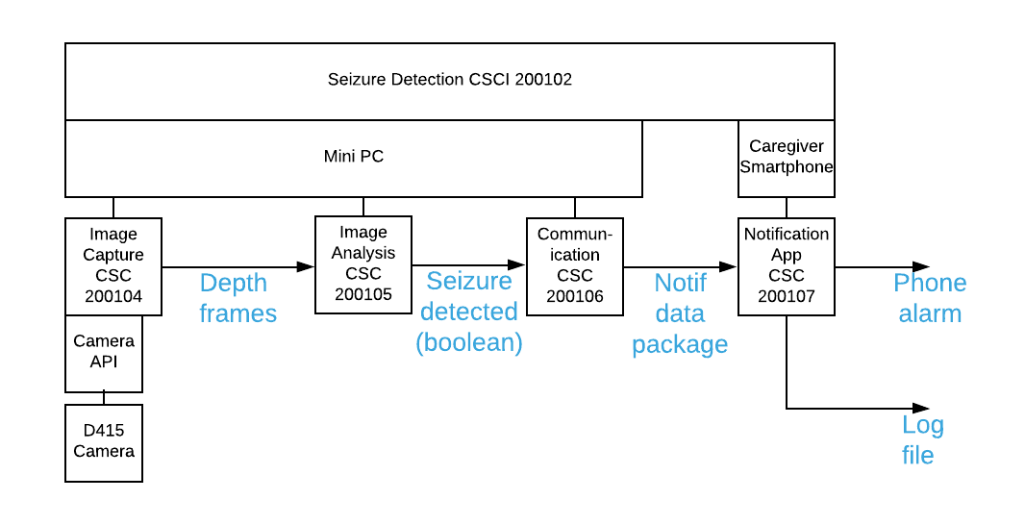
6.2 Image Analysis Software
Software component interactions
We understand the software required for final SDNS
Notes:
Explain the software components and their interactions that allow the SDNS to function. Highlight changes and advancements mostly

Slide 31
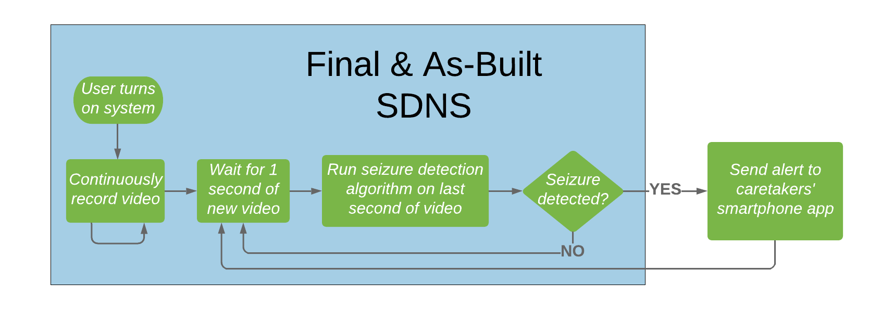
6.2 Image Analysis Software
New image analysis algorithm
Removed motion detection component
FFT window reduced from 5 seconds to 1 second
We understand the software required for final SDNS
Notes:
Explain the software components and their interactions that allow the SDNS to function. Highlight changes and advancements mostly

Slide 32
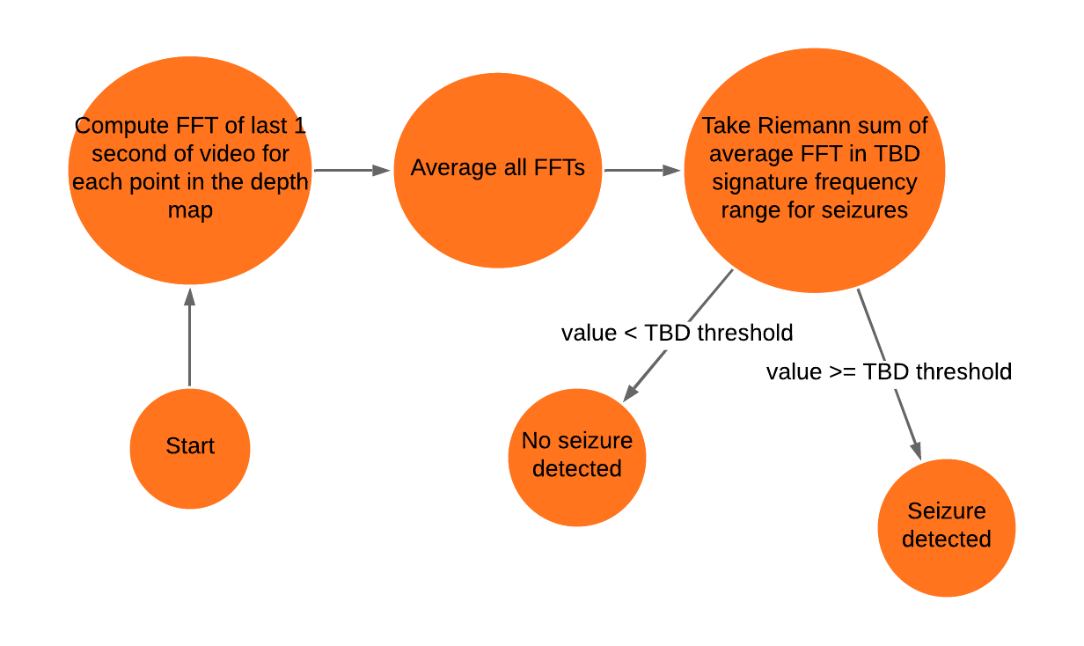
6.2 Image Analysis Software
Seizure detection algorithm (unchanged from CDR)
We understand the software required for final SDNS
Notes:
Explain the software components and their interactions that allow the SDNS to function. Highlight changes and advancements mostly

Slide 33
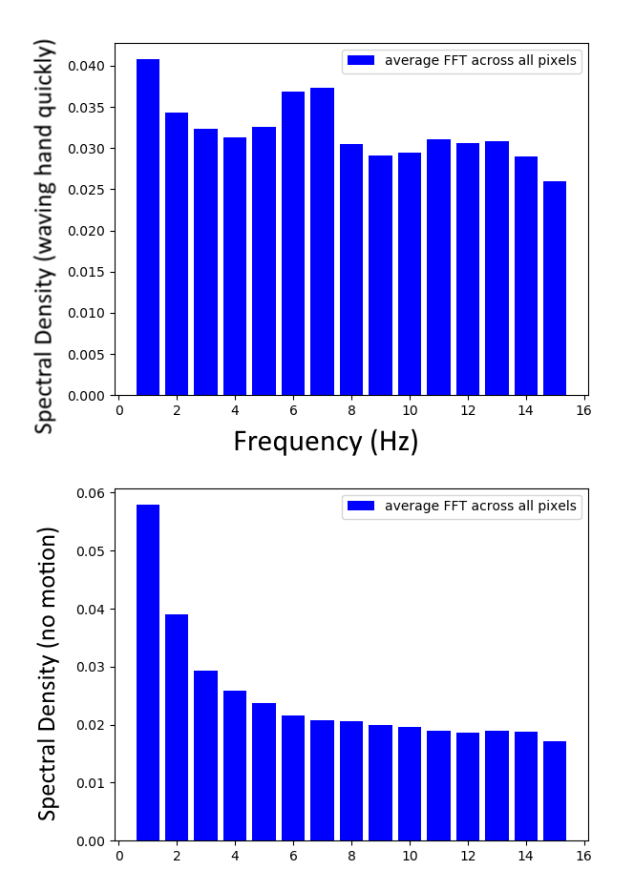
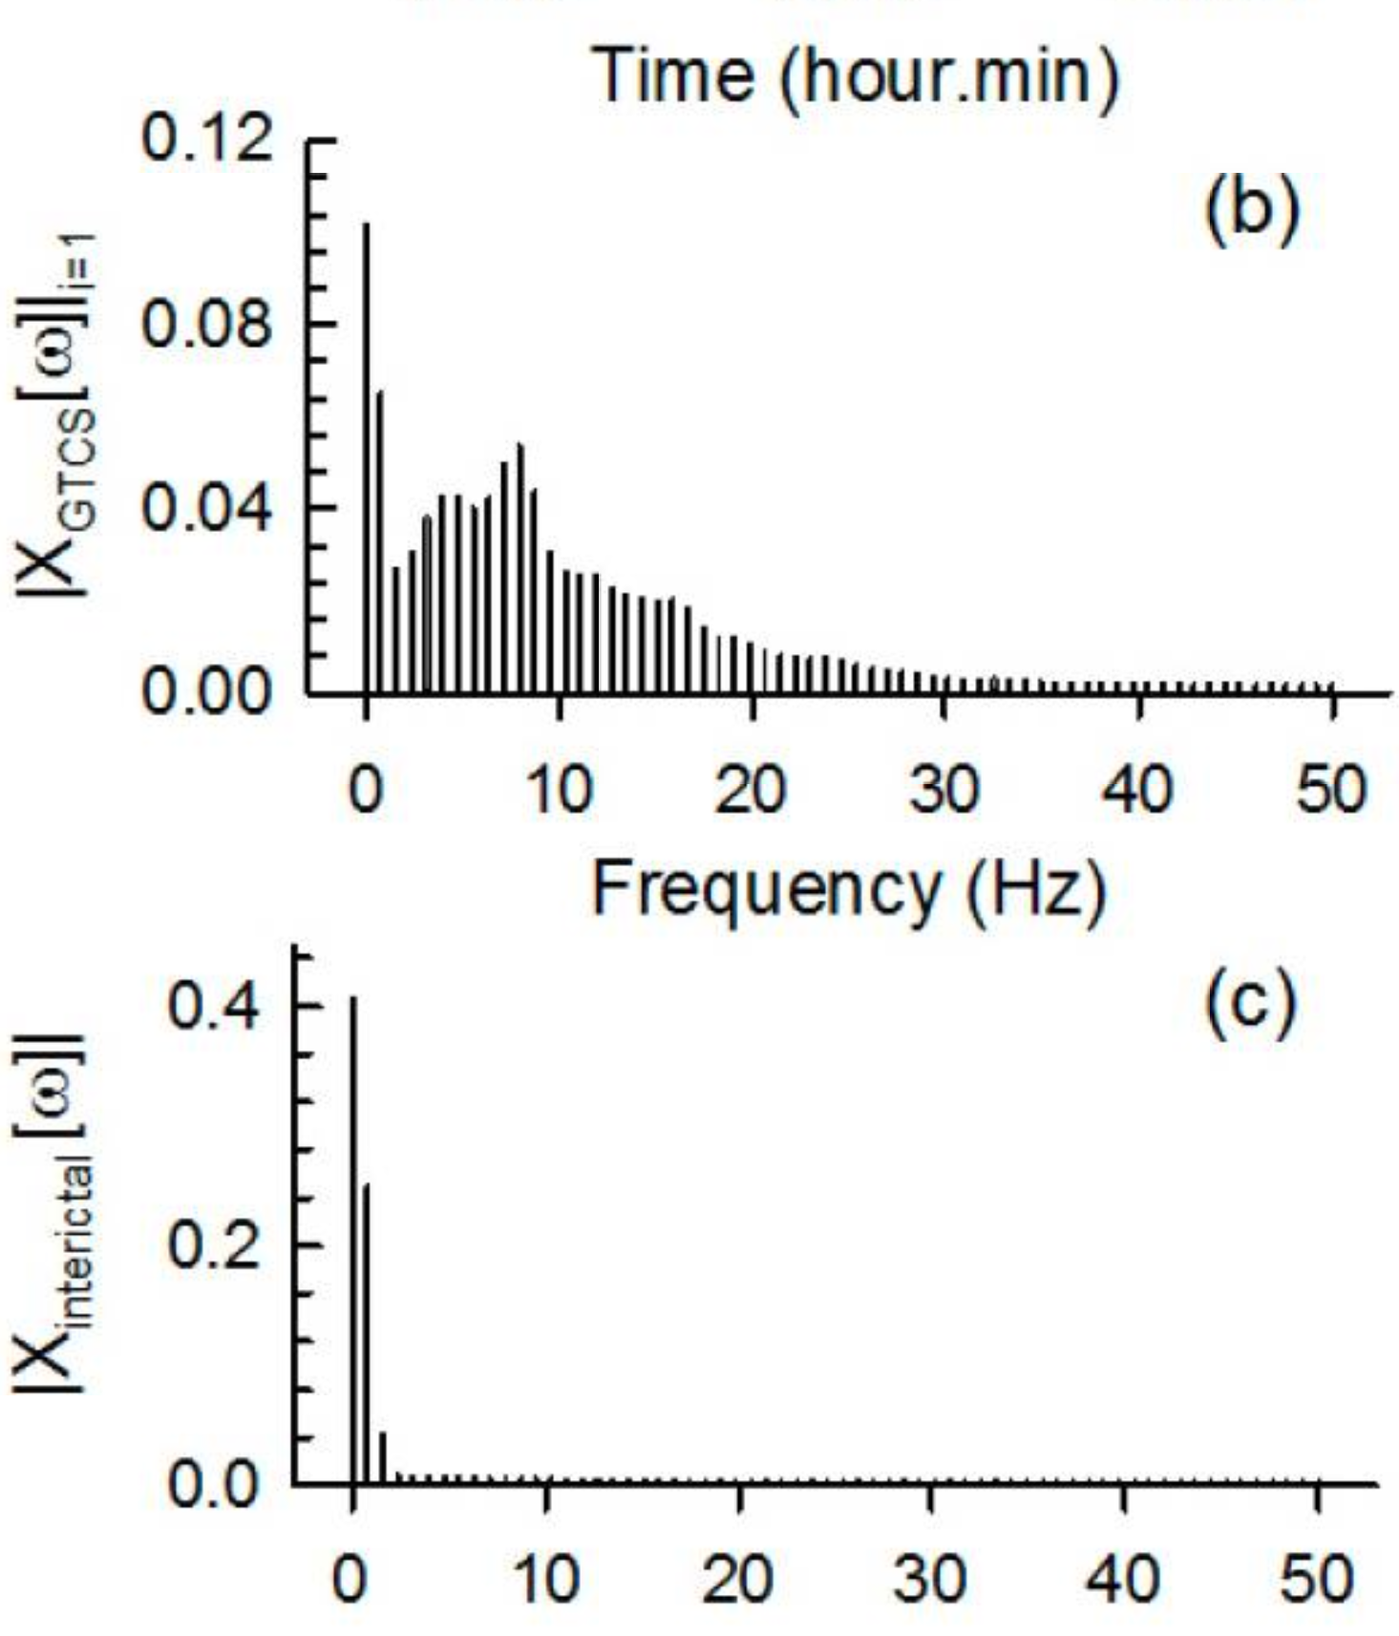
6.2 Image Analysis Software
Seizure detection algorithm (unchanged from CDR)
We understand the software required for final SDNS
Notes:
Explain the software components and their interactions that allow the SDNS to function. Highlight changes and advancements mostly

Slide 34
6.2 Image Analysis Software
Remaining components to be developed for FAR:
Setup for training AI
For 90% accuracy, may have to add:
Pre-processing (e.g. Intel RealSense SDK filters, NN for human detection)
More sophisticated classifier
Req # | Req description | Req verification description
SR 1.3, SSR 1.3.3 | Detect seizures with at least 90% accuracy | (T) Run mixed test set of depth videos. 90% average across positives and negatives
SR 1.4, SSR 1.4.1 | Detect seizures within 10 seconds of start of clonic phase | (T) Run seizure test set of depth videos. 90% of detections within 10 seconds
We understand the software required for final SDNS
Notes:
Explain the software components and their interactions that allow the SDNS to function. Highlight changes and advancements mostly

Slide 35
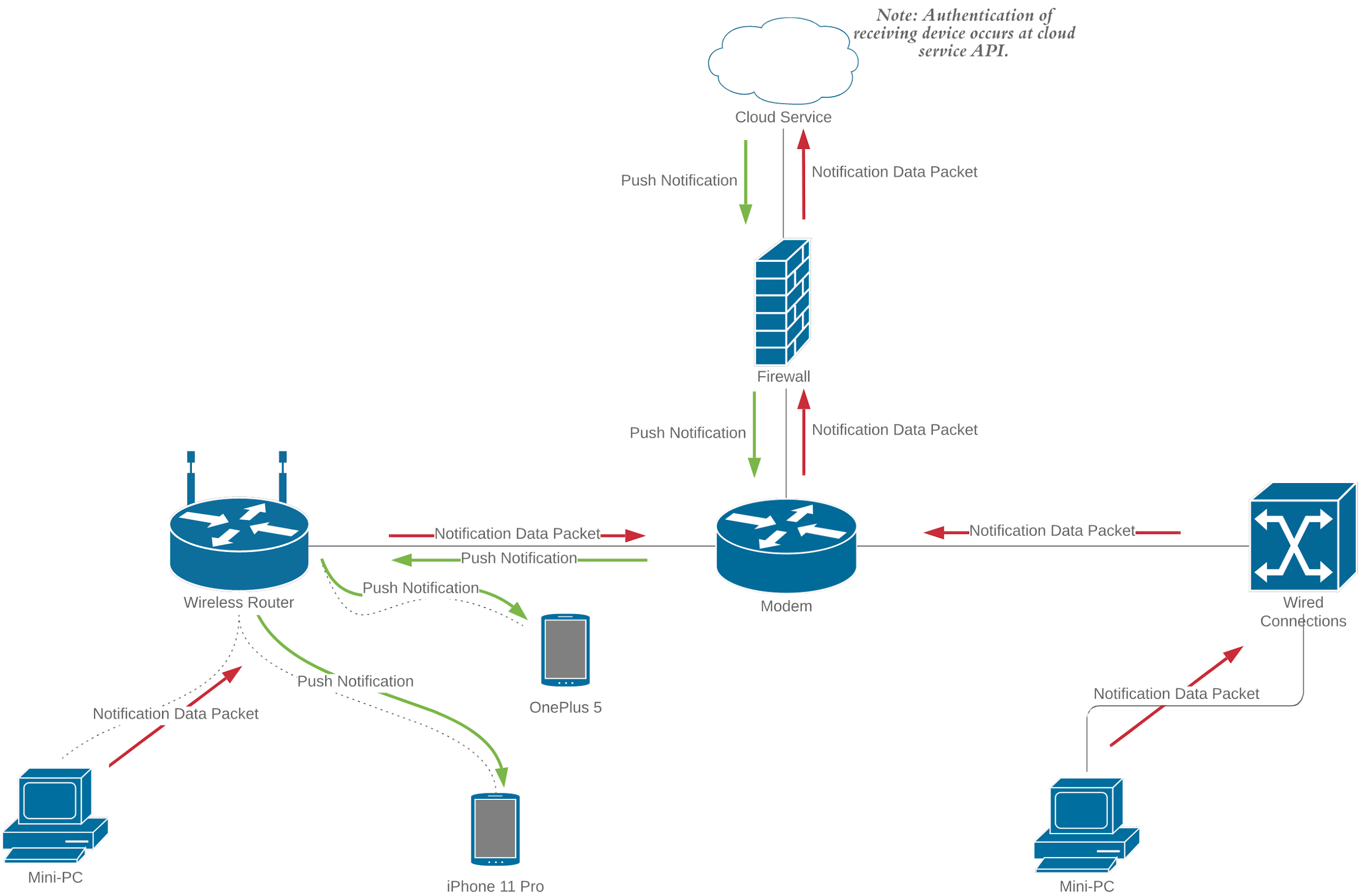
6.3 Notification App
200,205 - App Network Configuration - RevA
Cloud services AWS and Google Drive offer Push Notification services that can be integrated into the Notification subsystem. Integration goal not met by ISR.
Notes:
Explain how the connection between the Smartphone and the Mini PC works highlighting rationale for this network architecture.

Slide 36
6.4 Full Verification Plan
The acceptance and verification plans for these requirements have been written and can be found in document Document 100,204 V&A
These include verification plans for the system and subsystem requirements on the next slides
Verification of unmet requirements for ISR will be prioritized in the upcoming sprint
Upon passing of all tests, analysis, and inspections the full SNDS will be verified
Requirements that were not met at ISR are moved to FAR for verification.

Slide 37
6.4 Full Verification Plan
Requirement # | Requirement Title | Verification Method | Required Value | Units | Oper-ation | Actual Value | Pass/ Fail | Margin | First Verification
SR1.3 | Detection Accuracy | Test/Analysis | 90 | % | >= |  |  |  | FAR
SSR1.3.1 | Capture to Analysis | Inspection | 10 | Yes | = | 10 | Pass | 0 | CDR
SSR1.3.2 | Bedsheet | Test | 10 | Yes | = | 10 | Pass | 0 | CDR
SSR1.3.3 | Accuracy | Test | 90 | % | => |  |  |  | FAR
SR1.4 | Seizure Detection | Test | 10 | Seconds | <= |  |  |  | FAR
SSR1.4.1 | Seizure Timing | Test | 10 | Seconds | <= |  |  |  | FAR
Yellow indicates FAR Requirements
Notes:
Explain how the connection between the Smartphone and the Mini PC works highlighting rationale for this network architecture.

Slide 38
6.4 Full Verification Plan
All requirements in this table are for FAR
Requirement # | Requirement Title | Verification Method | Required Value | Units | Oper-ation | Actual Value | Pass/ Fail | Margin | First Verification
SR2.1 | Alarm | Test | 10 | Yes | = |  |  |  | FAR
SSR2.1.1 | Notif Send | Test | 10 | Yes | = |  |  |  | ISR
SSR2.1.2 | Notif to Alarm | Test | 10 | Yes | = |  |  |  | FAR
SR2.2 | Wireless | Test | 10 | Yes | = |  |  |  | ISR
SSR2.2.1 | Send over Internet | Test | 10 | Yes | = |  |  |  | ISR
SR2.3 | Notif Timing | Test | 5 | Seconds | <= |  |  |  | FAR
SSR2.3.1 | Notif Timing | Test | 5 | Seconds | <= |  |  |  | FAR
Requirements that were not met at ISR are moved to FAR for verification.

Slide 39
7.0 Risk Assessment

Slide 40
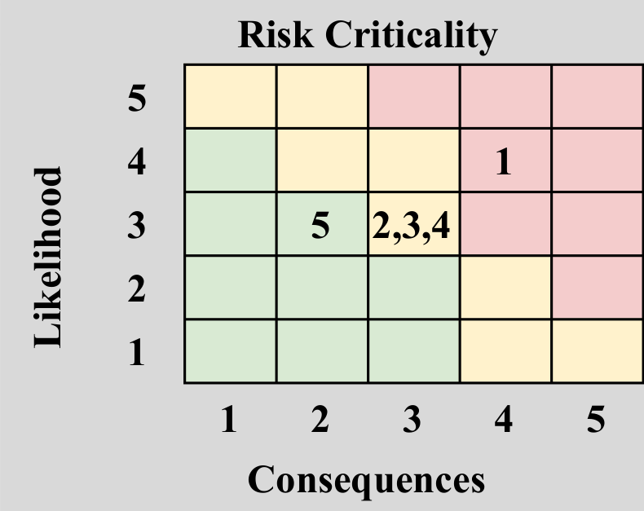
7.1 Risk Matrix
Accumulating real training data.
Push Notification integration.
Relying on external entities to collect data.
Testing algorithm accuracy.
Overheating processor.
We understand the updated risks, and have mitigation plans with clear trigger events.
Notes:
Here we need to get our risk assessment right, being careful with which is our top risks, which have been retired from our top risks (throughput has decreased greatly in risk I would say and data collection and relying on external entities has increased, but with a sound mitigation plan of change of scope)

Slide 41
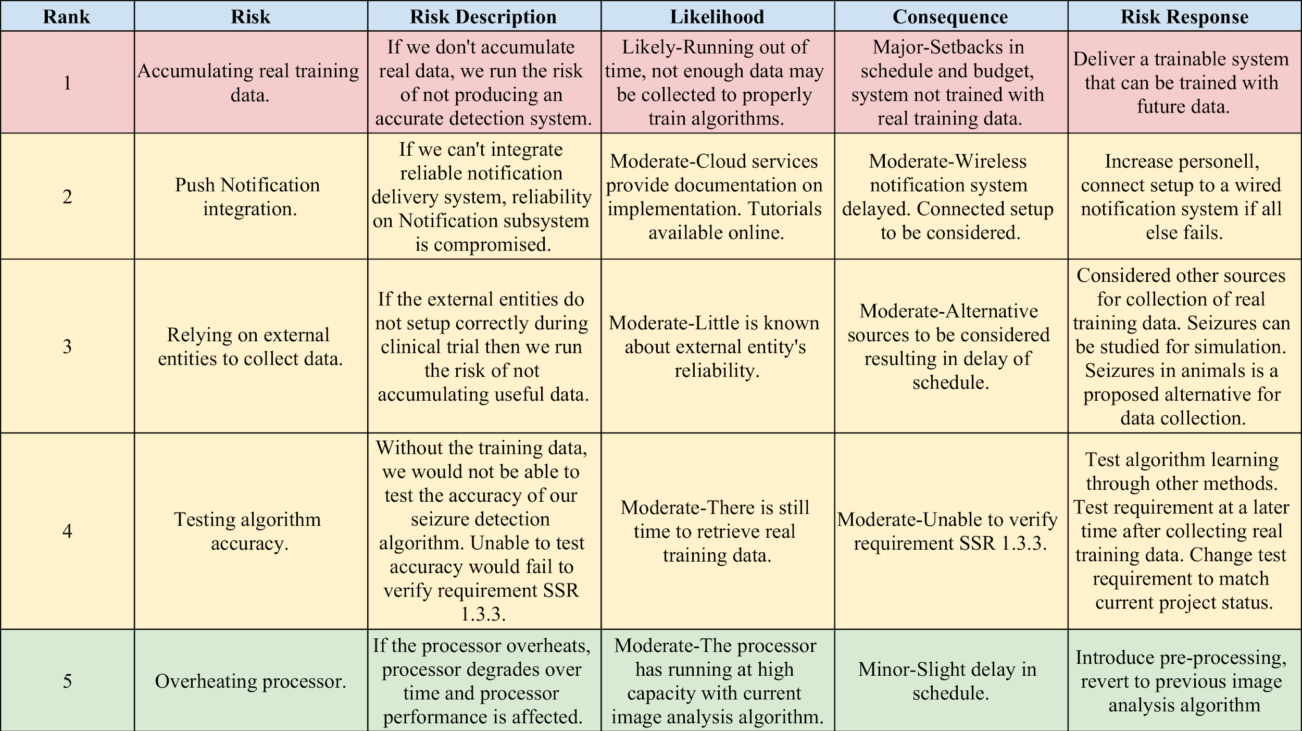
7.1 Risk Matrix
Accumulating training data has moved up in risk.
Notes:
Here we need to get our risk assessment right, being careful with which is our top risks, which have been retired from our top risks (throughput has decreased greatly in risk I would say and data collection and relying on external entities has increased, but with a sound mitigation plan of change of scope)

Slide 42
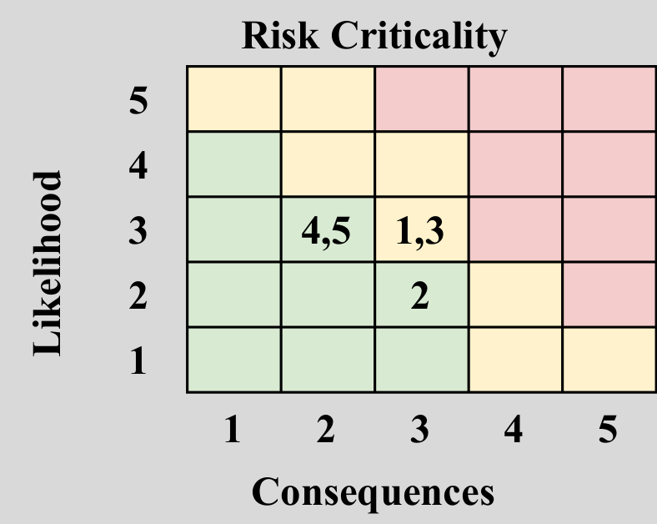
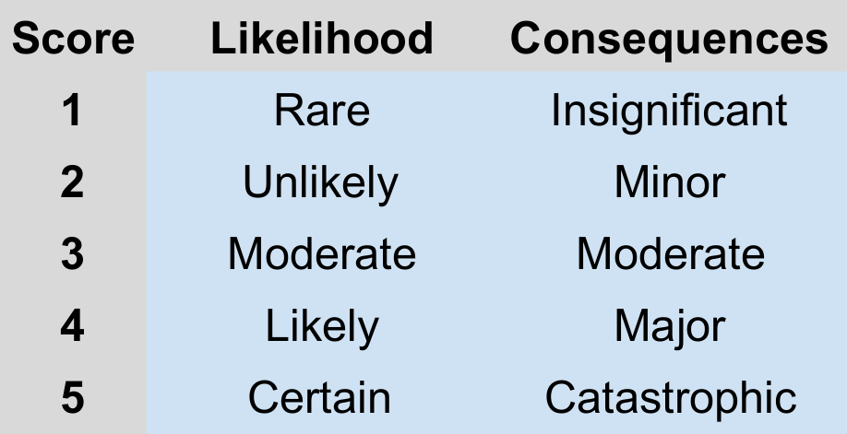
7.1 Risk Matrix
Mitigation
Mitigation plans still reduce our current risks.
Notes:
Here we need to get our risk assessment right, being careful with which is our top risks, which have been retired from our top risks (throughput has decreased greatly in risk I would say and data collection and relying on external entities has increased, but with a sound mitigation plan of change of scope)

Slide 43
8.0 Schedule and Cost Tracking

Slide 44
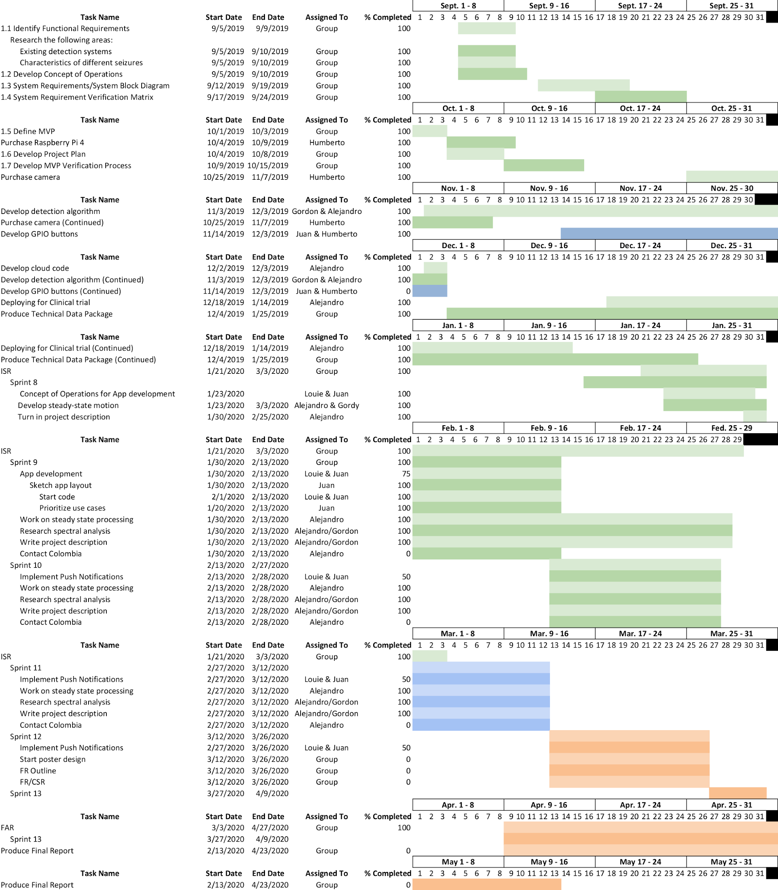
8.1 Schedule
We understand the timeline of events needed to reach our final design by Design Day
Notes:
The purpose here is to give an overview of what we have done so far, and what it is left to do and prove that we can complete the work. Explain if we have technical debt and if we can catch up
Include schedule similar to CDR presentation but updated to highlight what we have completed and what’s left. Should agree with slides 9 and 20 (2.1 and 5.1).
Talk about story points in previous sprints for ISR and how they will compare to our estimate of story points for upcoming sprints to show we can complete the work like how many hours have we been putting into sprints and how many we estimate we need for the next sprints
Discuss Technical Debt if any

Slide 45
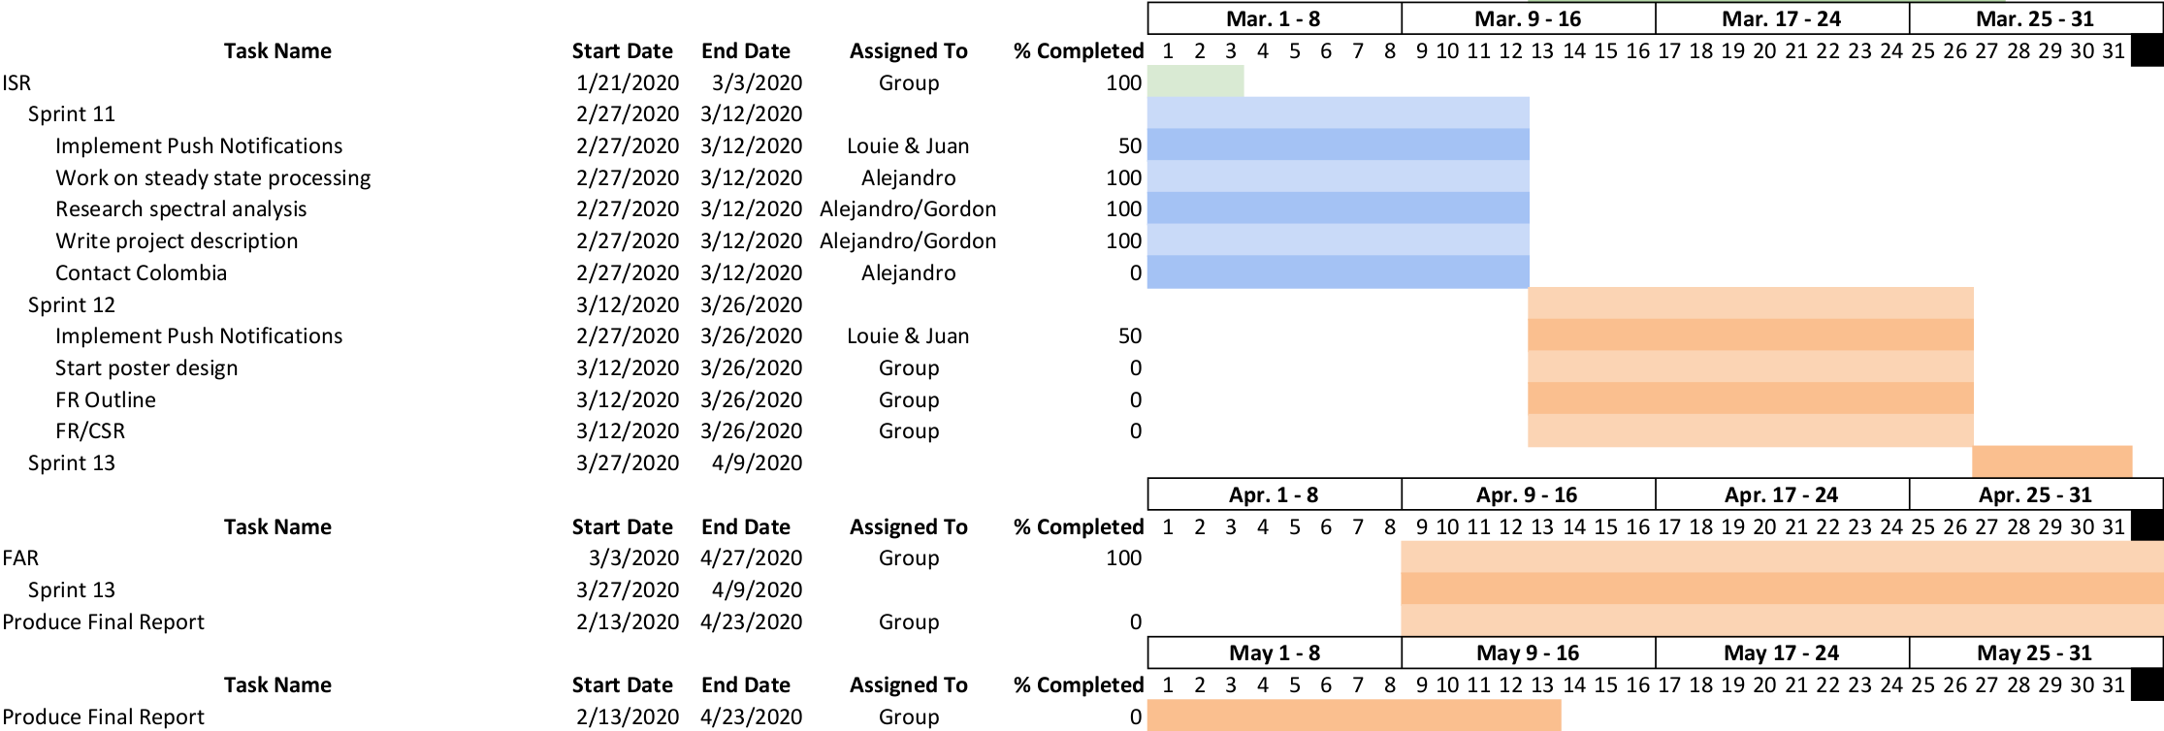
8.1 Schedule
Schedule for upcoming work.
Notes:
The purpose here is to give an overview of what we have done so far, and what it is left to do and prove that we can complete the work. Explain if we have technical debt and if we can catch up
Include schedule similar to CDR presentation but updated to highlight what we have completed and what’s left. Should agree with slides 9 and 20 (2.1 and 5.1).
Talk about story points in previous sprints for ISR and how they will compare to our estimate of story points for upcoming sprints to show we can complete the work like how many hours have we been putting into sprints and how many we estimate we need for the next sprints
Discuss Technical Debt if any

Slide 46
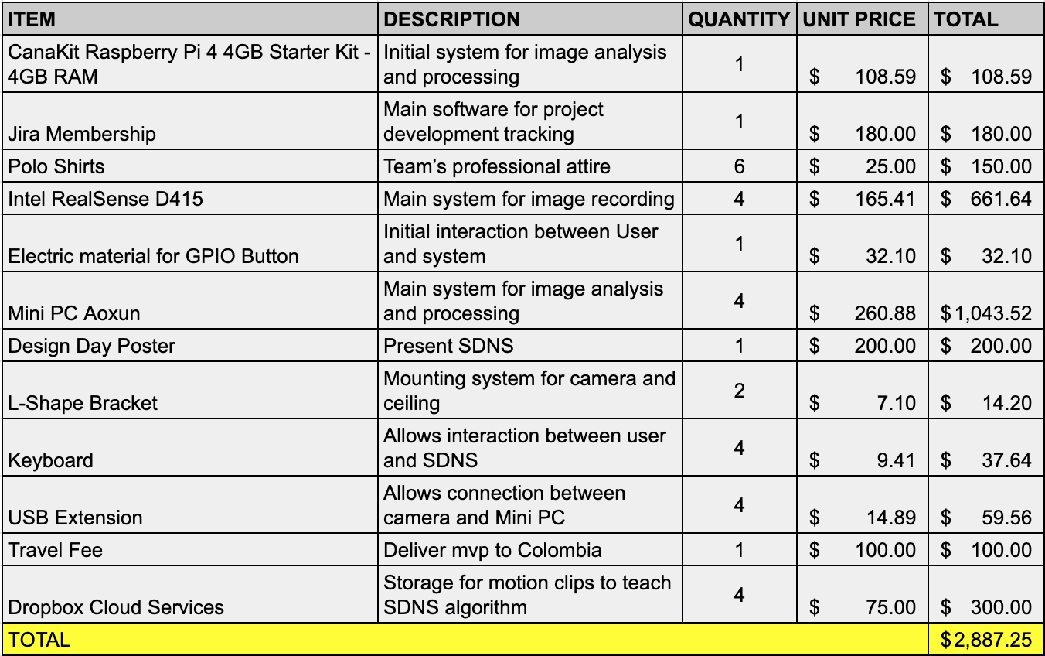
8.2 Cost
We can complete the project based on our Cost Analysis for FAR
Notes:
Goal is to explain why we can complete the project in terms of cost

Slide 47
8.2 Cost
The cost table is based on the components needed for a working SDNS
The total cost includes the systems delivered in Colombia for clinical trials; the two systems installed in the USA were bought by out sponsor.
We can complete the project based on our Cost Analysis for FAR
Notes:
Goal is to explain why we can complete the project in terms of cost

Slide 48
9.0 Summary

Slide 49
9.0 Summary
For ISR we have successfully:
Verified requirements SSR1.2.2, SR3.1, SSR3.1, SSR3.2.2, SSR3.2.3
Seizure detection running at steady state
Log file created and displayed
Completed final designs for FAR
Flowed down all system requirements
Failed to verify requirements SSR2.1.1, SR2.2, SSR2.2.1, SR 3.2, SSR 3.2.1
All are related to communication between mini PC and smartphone app
We have built and verified our ISR SDNS and we are ready to build and verify our FAR SDNS
Notes:
Summary of review emphasizing on key points like what we proposed to do, what we did and what's coming up for our next review

Slide 50
Questions?
Thank you!

Slide 51
Backup slides

Slide 52
New image analysis algorithm
Advantages of new algorithm:
Ability to expand to more sophisticated machine learning classifiers
Possibility of detecting seizures that have small motions
Easier to perform training and verification
Easier for future open source developers to understand current algorithm
Eliminates need for calibration step
We carefully weighed our options and chose the better design for detecting seizures
Notes:
Summary of review emphasizing on key points like what we proposed to do, what we did and what's coming up for our next review

Slide 53
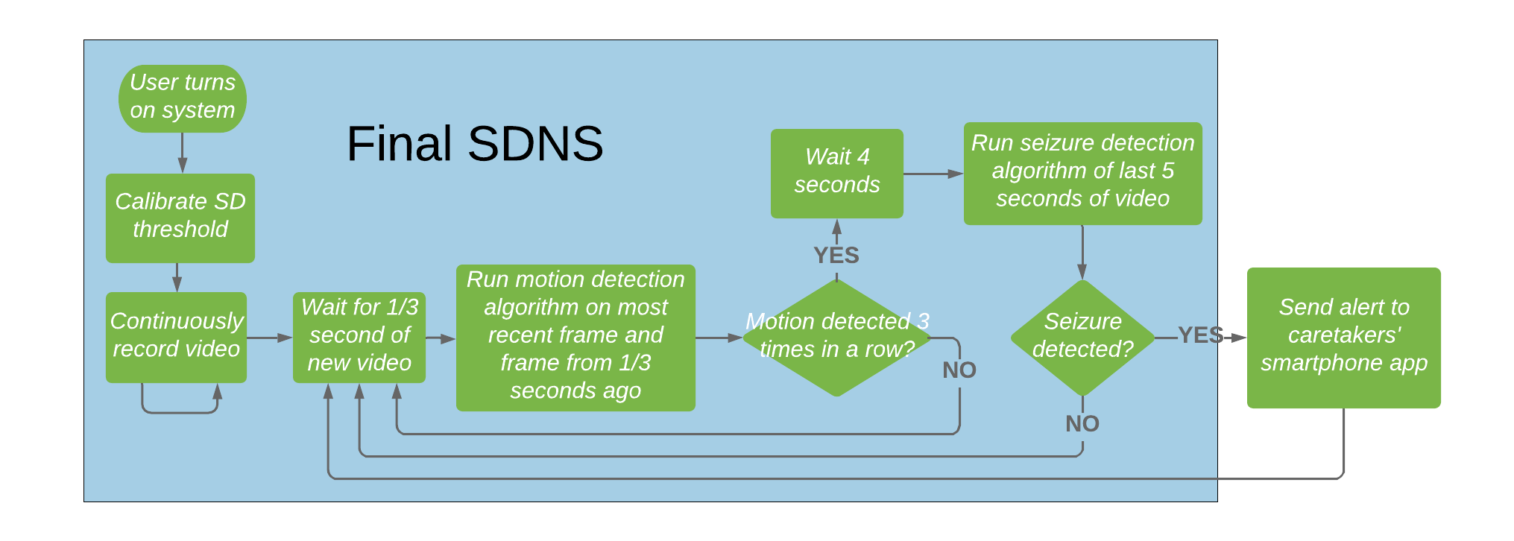
Previous image analysis software design
Advantages of new algorithm:
Ability to expand to more sophisticated machine learning classifiers
Possibility of detecting seizures that have small motions
Easier to perform training and verification
Easier for future open source developers to understand current algorithm
Eliminates need for calibration step
We carefully weighed our options and chose the better design for detecting seizures
Notes:
Summary of review emphasizing on key points like what we proposed to do, what we did and what's coming up for our next review

Slide 54
Image analysis software design comparison
NEW
OLD
We carefully weighed our options and chose the better design for detecting seizures
Notes:
Summary of review emphasizing on key points like what we proposed to do, what we did and what's coming up for our next review

